Slide 1
CS-Studio: Probe

Slide 2


Probe
A simple application to connect to pv’s
Monitor pv’s (caget, camonitor)
Write to pv’s (caput)
Opening probe
Menu: CSS → Diagnostic Tools → Probe
Toolbar:
Context Menu*: Process Variable → Probe

Slide 3
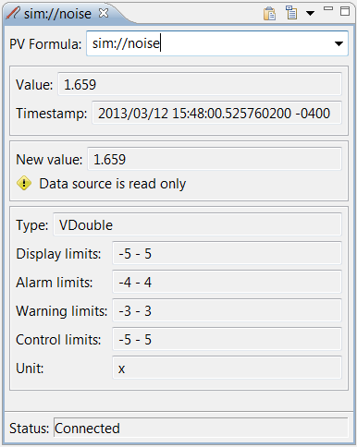
Probe - getting started
Connect to a simple scalar pv (simulation)
In the PV Formula field type “sim://noise” and hit the return key
Connect to a simple scalar pv (softIOC)
In the PV Formula field type “XF:31IDA-OP{Tbl-Ax:X1}Mtr.RBV” and hit the return key
Notes:
TODO: pv name

Slide 4
Probe - deciphering the data
Value:
Shows the current value of the pv and the timestamp associated with it
Change Value:
The new value field is used to write new values to the pv If the pv is read only this field is disabled
MetaData:
Additional information about the pv Type, Display limits, Alarm limits, units…..

Slide 5
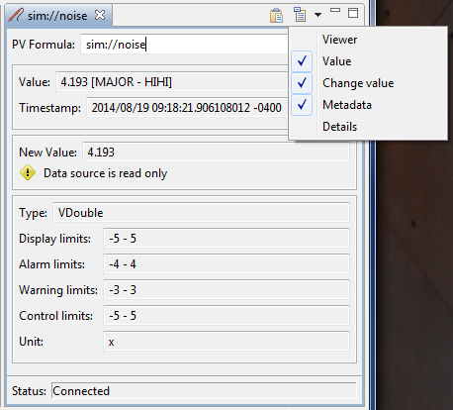
Probe - deciphering the data
The drop down menu allows you to selected the additional information about the pv and the connection to be displayed
Viewer
Value
Change value
Details

Slide 6
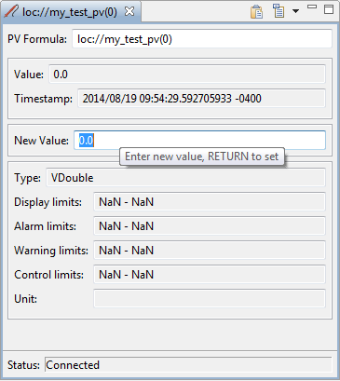
Probe - writing a value
Connect to a simple scalar pv (local)
In the PV Formula: field type “loc://my_test_pv(0)” and hit RETURN
In the New Value: field enter any valid number and hit RETURN

Slide 7
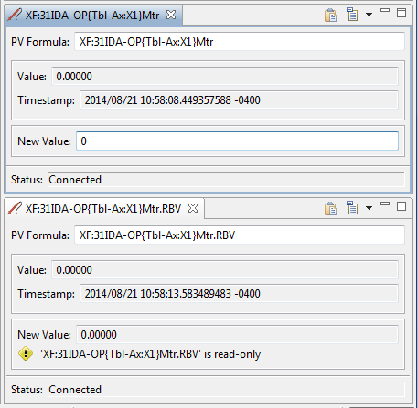
Probe - writing a value
Open 2 probes
Move the probe views so that they can be both viewed simultaneously
In the first probe enter the setpoint pv PV: XF:31IDA-OP{Tbl-Ax:X1}Mtr
In the second probe enter the Readback pv PV: XF:31IDA-OP{Tbl-Ax:X1}Mtr.RBV
Set a new motor position (-100 and 100)

Slide 8
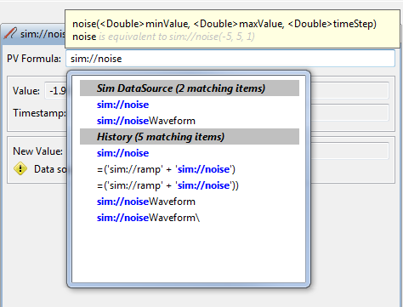
Probe - Autocomplete
Autocomplete
History
ChannelFinder
Predefined simulation pv’s (Datasources)
Formula functions
Notes:
TODO: add autocomplete for softIOC pv

Slide 9

Probe - Help
Help → Help Content
CSS Applications → Diagnostic Tools → Probe

Slide 10
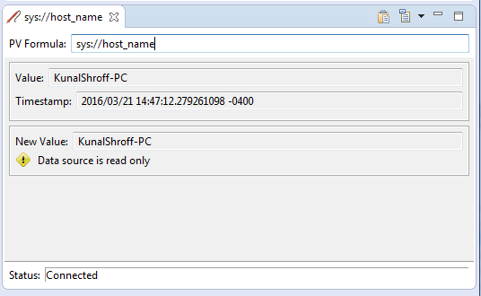
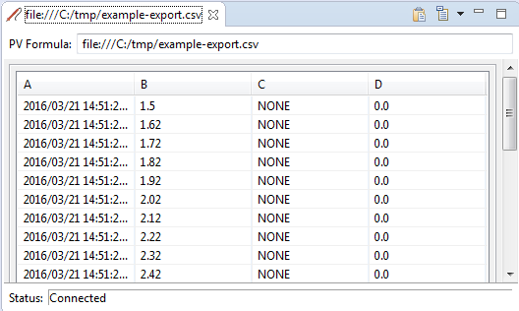
Probe – process variable (Datasource)
type://some_pv_name
Datasources
System (sys://)
Local (loc://)
Simulation (sim://)
File(file://)
PVAccess (pva://)
Help
CSS Core → Process Variables

Slide 11
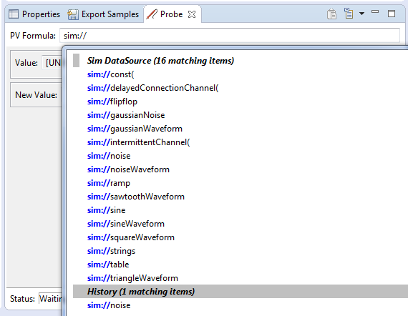
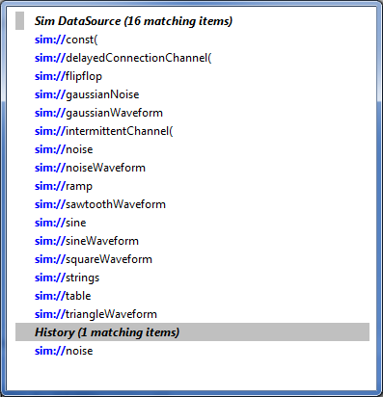
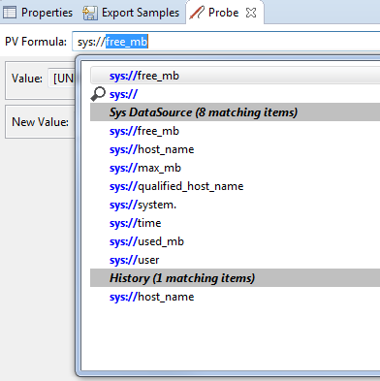
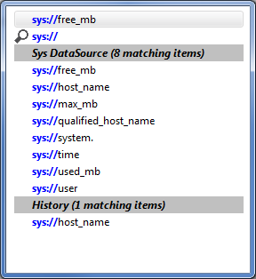
Probe - Autocomplete Datasources
Autocomplete will list the various pv’s available for a particular datasource
Figure 1

Slide 12
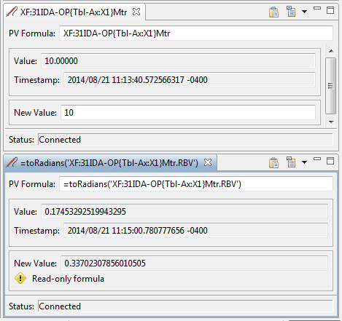
Probe - pv’s and formulas
Formulas
Mathematical operations
Logical operations
Array operations
Create/modify tables and arrays
Start with a ‘=‘
Don’t use formulas for things that should be done in the IOC

Slide 13
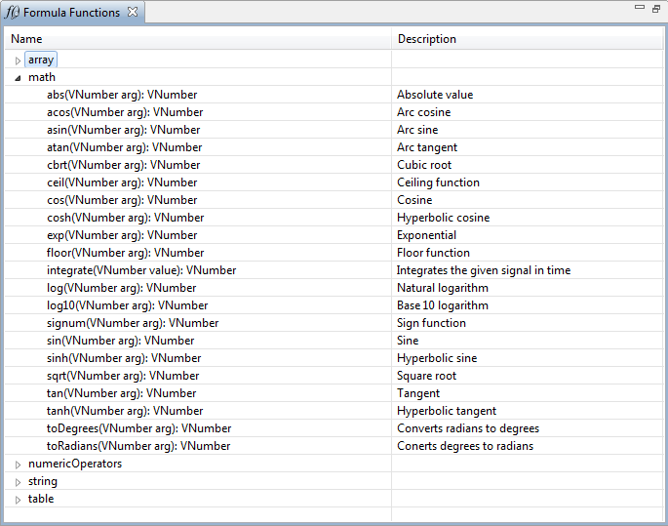
Probe - pv’s and formulas
CSS →
Debugging →
Formula Functions

Slide 14
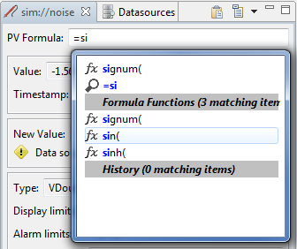

Probe - Autocomplete formula
Figure 1: Autocomplete will list the formula functions matching your text.
Figure 2: Autocomplete will help you fill the formula function with the correct parameters.
Figure 1
Figure 2

